Slide 1
GenAi Insights Generator and LLM Sentiment Analysis of Financial News Data
Done by :
Zied Triki
GenAi and MLOps Engineer

Slide 2
Full Pipeline Architecture

Slide 3
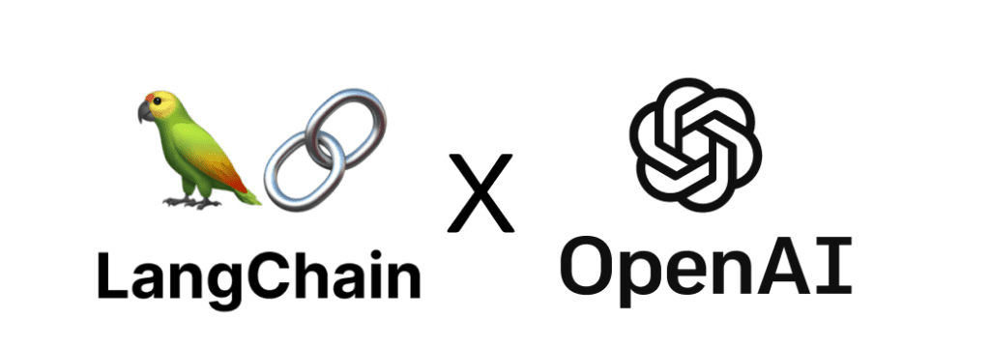
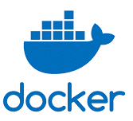



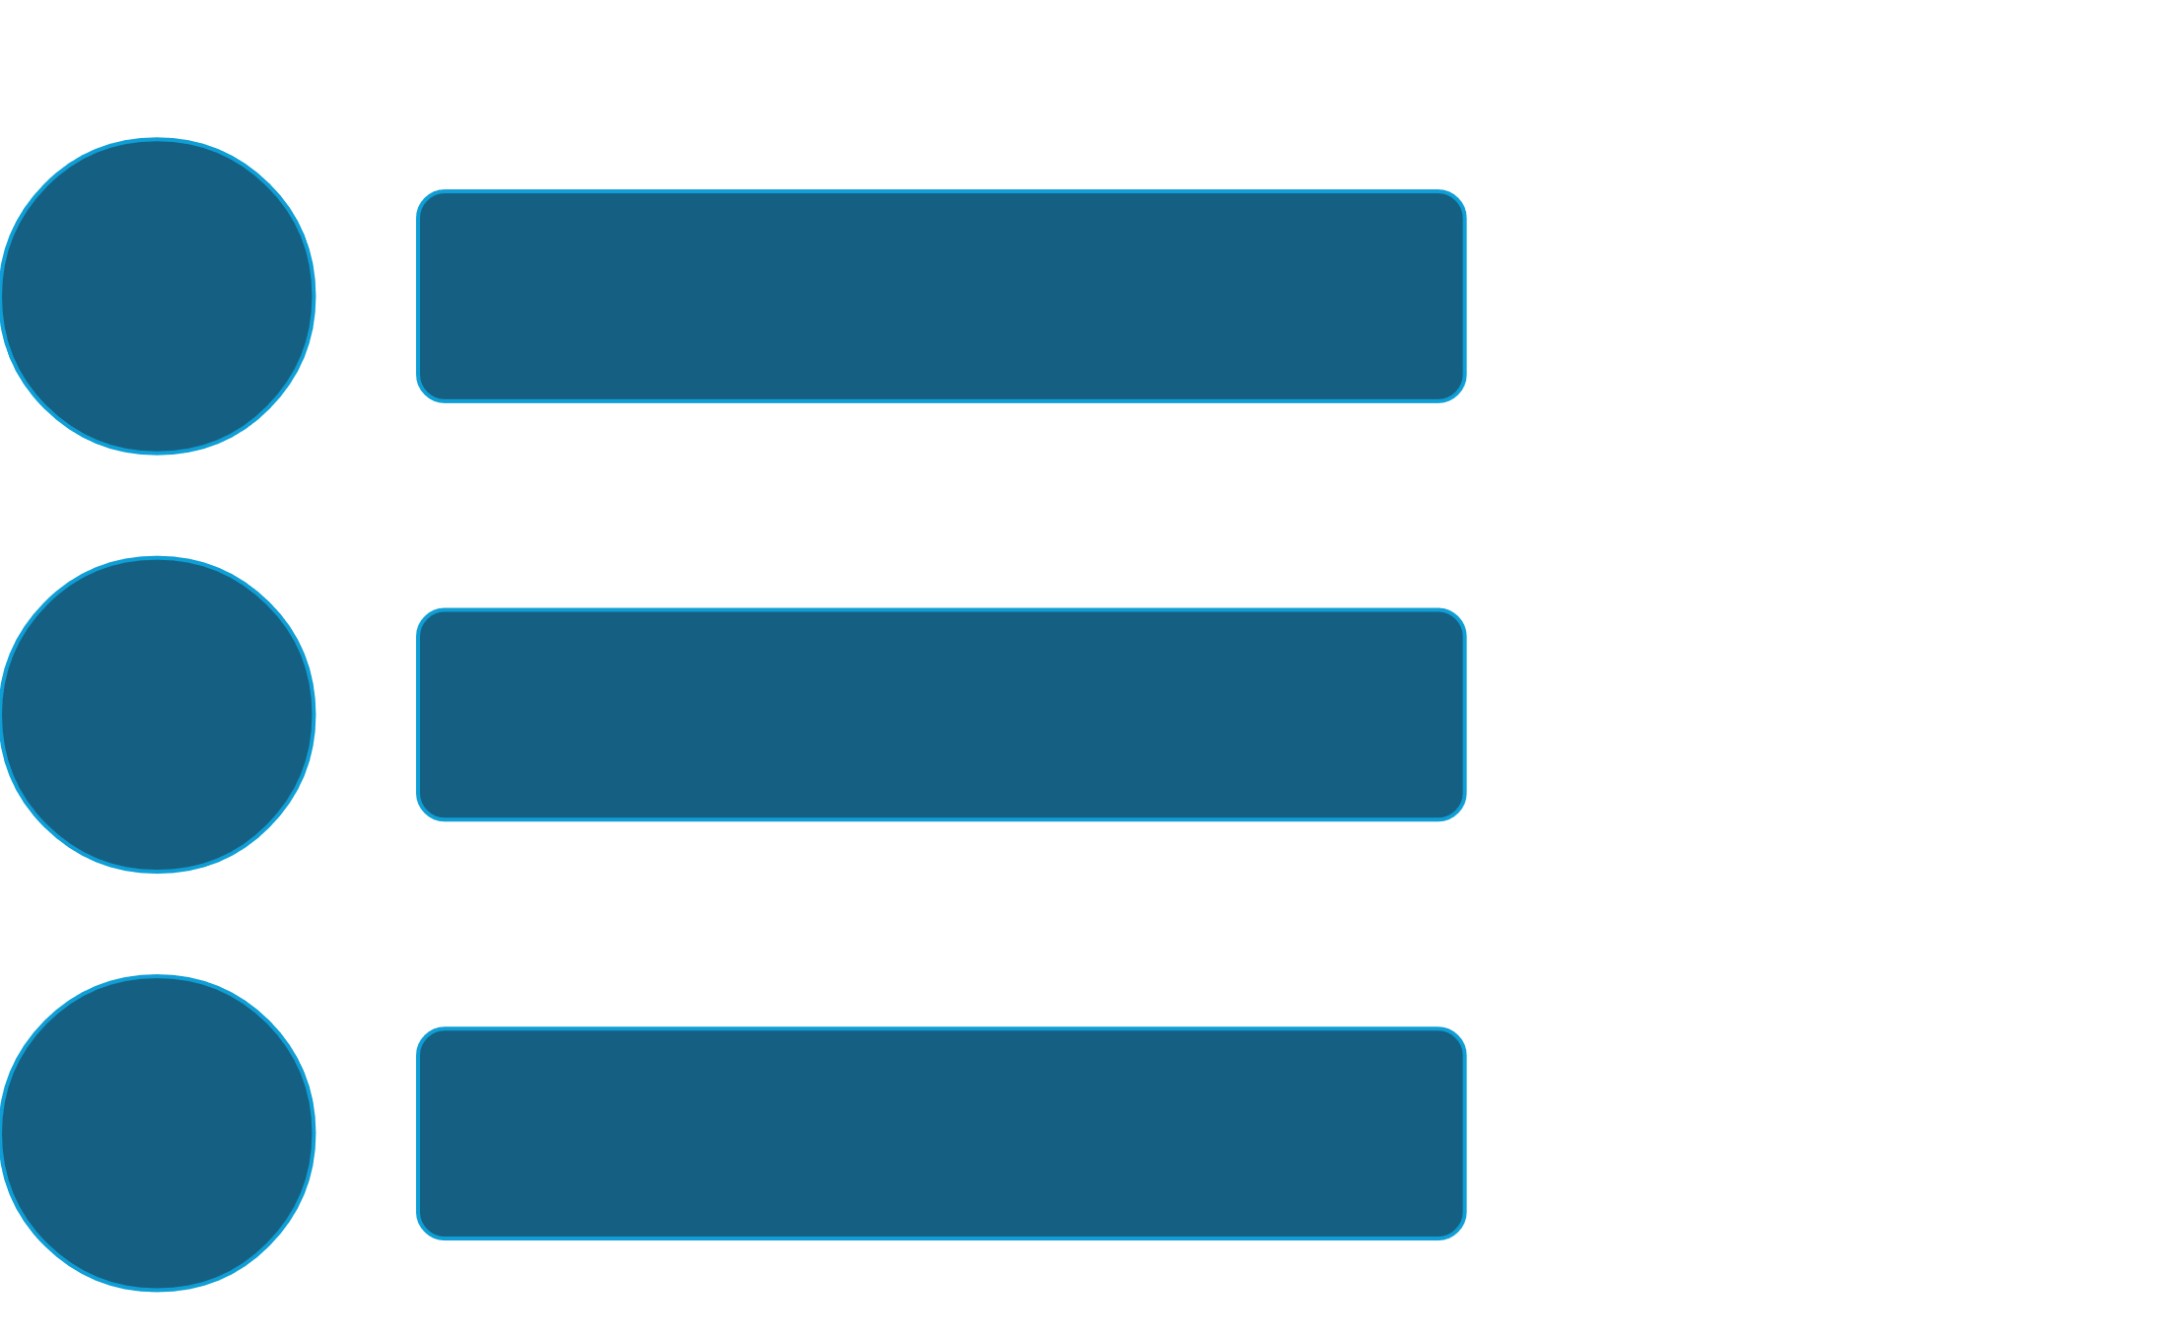



GenAi Insights generation and Sentiment Analysis Process Architecture
Text Summarization
GenAi Insights and LLM Sentiment Analysis
Model Deployment
Web Scraping
Text Pre_Processing
GPT API Inisghts’ generation
Scraped Financial
News Data
Processed and Summarized Financial Data
Summarized Financial
News Data
Dataframe with insights generated
Guardian API
Langchain and
Open Ai GPT 4.o API
LLM Sentiment Analysis
Sentiment Scored
Dataframe
Meta_LLM_
BART_LARGE
FINBERT LLM

Slide 4
Pipeline Detailed Steps

Slide 5
Web Scrapping :
Scraped financial news data between 2022 and 2024 from the Guardian API
Applied initial Processing to the result to prepare it for the Pre_processing Step

Slide 6
2. Text Processing
Applied NLP Text Pre_processing to the result to obtain a Dataframe with the PublicationDate and the corresponding processed article content
→ Techniques used:
Removing html tags and links
Removing Emails and Punctuation
Lowering Strings
Replacing Contractions
Removing Stop Words

Slide 7
3. Text Sumamrization
Applied the Meta_BART_LARGE_LLM model to summarize the article body for a better sentiment extraction accuracy
Added the column summarized_article_content holding the sumamrizations to the final Dataframe

Slide 8
4. Sentiment Analysis
Applied the the FINBERT by ProsusAI LLM Model to categorize the sentiment for each article
Extracted the sentiment scores from the sentiment category
Adjusted the scores based on the class distributions from the FinancialPhraseBank Dataset to take into account the negative articles’ tendence bias
Scored the test dataset with the same pipeline

Slide 9
5. GenAi Insights’ Generation:
We use the ChatOpenAI module from LangChain that calls the GPT_OPEN_AI API.
We do prompt Engineering with the ChatPromptTemplate from LangChain
We Feed the LLMChain from LangChain with the GPT_LLM_API and the prompt constructed to generate the Financial Insights

Slide 10
6. Model Deployment:
We Containerize our Flask Deployment Application along with all its dependencies with Docker
We feed the Docker container created to the Kubernetes Cluster that we need to provision Locally or On the Cloud

Slide 11
THANK YOU

